Slide 1
Predicting King County, Washington House Prices
By: Kierra Dangerfield

Slide 2
Problem
Buying and/or selling a home can be a stressful time in someone’s life.
Buyers and sellers need to be able to predict house prices.
It can be difficult to determine what features of a house will affect a home’s price.
Need to create a predictive model that home sellers, home buyers, and online property listings can use.

Slide 3
Data: Overview & Cleaning
Data is from Kaggle
Data is based on houses sold between May 2014 to May 2015.
There were no duplicates

Slide 4
Data Cleaning: Missing Values
There were some missing values.
There were only 2 rows with missing values in the ‘sqft_above'.
There is a row with the "bedrooms" column as 33.

Slide 5
Data Cleaning: Outliers
There are 13 rows with the “bedrooms” column as 0.
There are outliers in the "sqft_lot" column.
There are 5 rows with the “sqft_lot” above 75,000 square footage.
The average went from over 15k to almost 10k square footage.

Slide 6
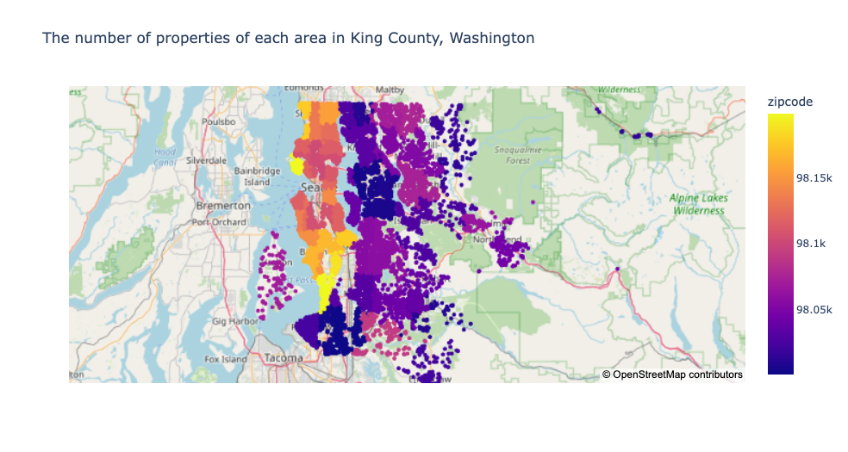
Analysis: Location

Slide 7
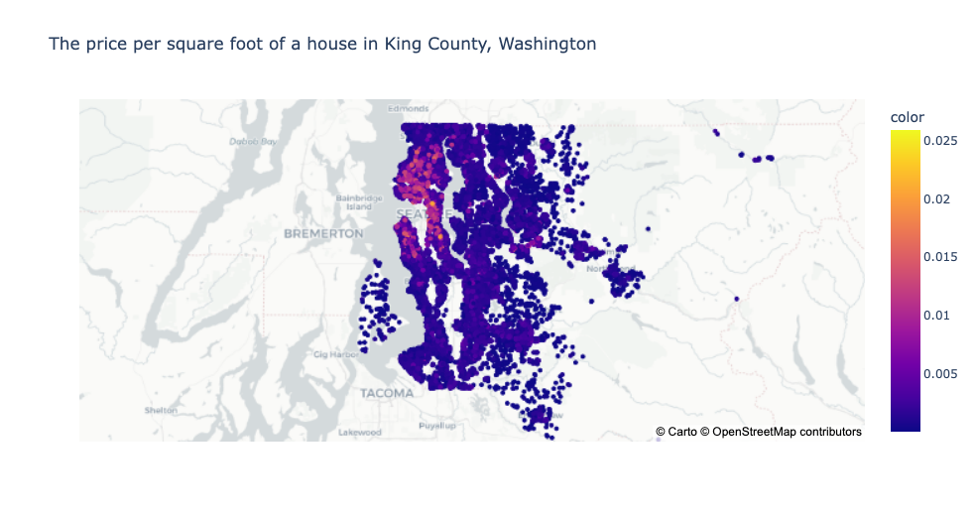
Analysis: Location Cont.

Slide 8
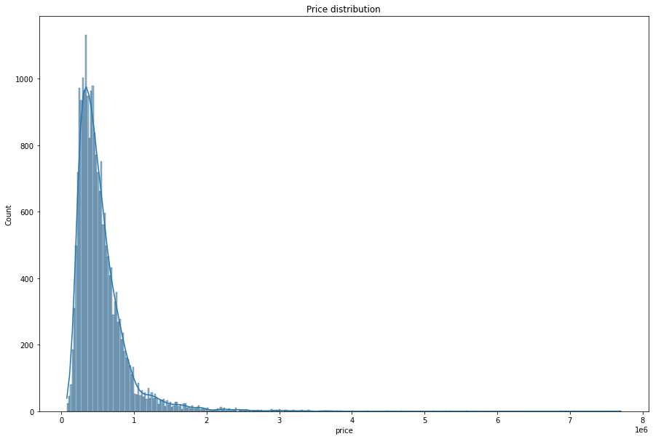
Distribution of Target Variable: Price
Based on the distribution of price
There are two modes: $350,000 and $450,000.

Slide 9
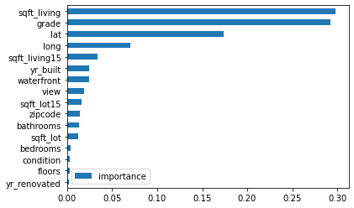
Random Forest Features Importance
The feature importance chart tells us the most important features in determining the price of the house.
“Sqft_living” is the square footage of a house.
It is the most important feature in determining the price of a home.

Slide 10
Random Forest Features Importance
“Grade” represents the overall grade given to the housing unit, based on King County grading system. 1 poor ,13 excellent
“lat” and “long” represents the latitude and longitude of a house.
We will focus on these top 4 features in determining the price.

Slide 11
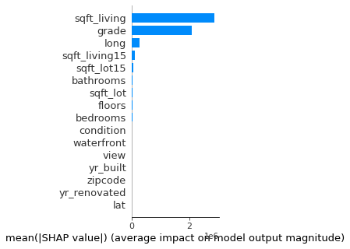
SHAP Feature Importance
SHAP is based on feature attributions.
Based on the SHAP feature importance, “sqft_living”, “grade”, “long”, “sqft_living15” are the top four features.
The RF Feature Importance and the SHAP Feature Importance have similar top 4 important features.

Slide 12
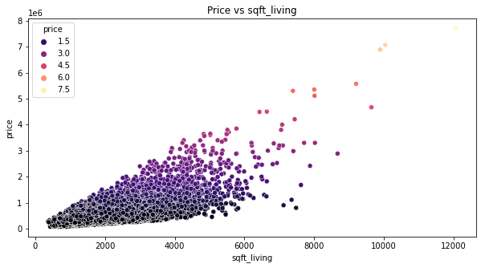
Analysis: Square Footage vs Price
This chart is showing that the higher the square footage of a house, typically the higher the price will be.
The most expensive home has 12,000 square feet.
Most of the homes are between 2,000 and 6,000 square feet.

Slide 13
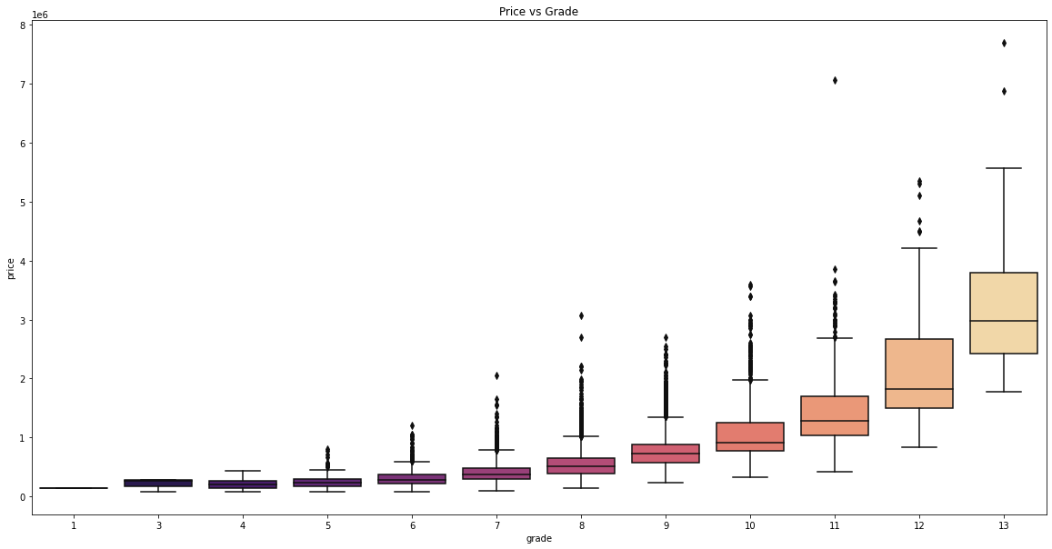
Analysis: Grade vs Price
The grade is based off of King County’s grading system.
You should expect a higher house price if you have a better grade.
Typically, the houses with a higher grade have a higher house price.

Slide 14
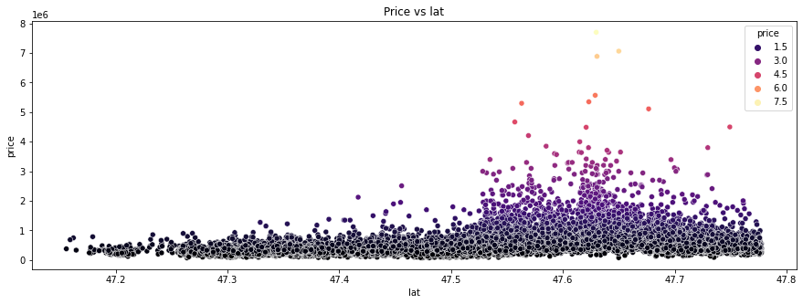
Analysis: Latitude vs Price
Seattle, Washington has a latitude of 47.608013.
The closer a house is near Seattle, it’s a possibility of it will have a higher house price.
The higher priced homes are in between 47.5 and 47.7 latitude.

Slide 15
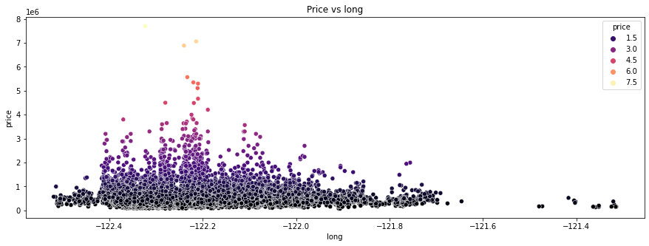
Analysis: Longitude vs Price
Seattle, Washington has a longitude of -122.335167.
The closer a house’s longitude is near Seattle, it’s a possibility of it will have a higher house price.
The higher priced homes are in between -122.4 and -122.2 longitude.

Slide 16
Results: Top Features
‘grade’, ‘sqft_living’, ‘lat’, and ‘long’ are the top features in considering a house’s price.
“Bedrooms”, “condition”, “floors”, “yr_renovated” are insignificant variables based on the feature importance.
I used 3 models to determine the best model to use

Slide 17
Results: Three Models
Linear Regression shows the relationship between 2 variables.
Ridge Regression is a L2 regularization that helps with overfitting.
Random Forest Regressor is a supervised learning algorithm that uses ensemble learning method for regression to make a more accurate prediction than a single model.
Model | Best Parameters | RMSE Score | MAPE
Linear Regression | n/a | $202,853 | 26.7%
Ridge Regression | n_jobs: 1 | $202,870 | 26.7%
Random Forest Regressor | max_depth: 30, max_features: 'auto', n_estimators: 400 | $127,996 | 13.1%

Slide 18
Results: Three Models - cont.
I used a Linear Regression, Ridge Regression, and a Random Forest Regression model.
Used GridSearchCV to determine the best parameters
Random Forest Regressor performed the best based on the RMSE (root mean squared error)
Model | Best Parameters | RMSE Score | MAPE
Linear Regression | n/a | $202,853 | 26.7%
Ridge Regression | n_jobs: 1 | $202,870 | 26.7%
Random Forest Regressor | max_depth: 30, max_features: 'auto', n_estimators: 400 | $127,996 | 13.1%

Slide 19
Results: RMSE AND MAPE
Root Mean Squared Error (RMSE) is the square root of the average squared error.
RMSE is used to evaluate the quality of predictions by showing how far predictions fall from measured true values.
Mean Absolute Percentage Error (MAPE) is used to measure forecast accuracy.
MAPE is the average of the percentage errors
Model | Best Parameters | RMSE Score | MAPE
Linear Regression | n/a | $202,853 | 26.7%
Ridge Regression | n_jobs: 1 | $202,870 | 26.7%
Random Forest Regressor | max_depth: 30, max_features: 'auto', n_estimators: 400 | $127,996 | 13.1%

Slide 20
Results: Random Forest Models
The parameters for the model is the following: max_depth=30, max_features='auto', n_estimators=400)
I created 4 different Random Forest Models with different independent variables.
‘Rf_model’ is the model with the original independent variables.
Model | Test R² score | RMSE Score | MAPE
rf_model | 0.88 | $126,597 | 13%
rf_model2 | 0.87 | $142,506 | 13.8%
rf_model3 | 0.83 | $159,335 | 15%
rf_model4 | 0.70 | $213,361 | 29%

Slide 21
Results: Random Forest Models Cont.
“rf_model2” is without the insignificant variables based on the Random Forest Feature Importance.
"rf_model3” is the top features based on the Random Forest feature importance.
“rf_model4” is the top features based in the SHAP feature importance.
“rf_model” is the model that has performed the best.
Model | Test R² score | RMSE Score | MAPE
rf_model | 0.88 | $126,597 | 13%
rf_model2 | 0.87 | $142,506 | 13.8%
rf_model3 | 0.83 | $159,335 | 15%
rf_model4 | 0.70 | $213,361 | 29%

Slide 22
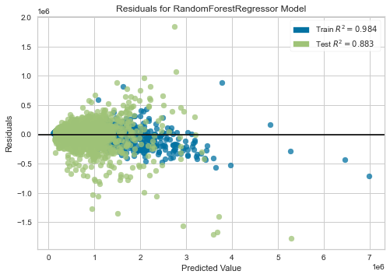
Conclusion
Before a home buyer, home seller, or online property listing can use this model, there will need to be improvements.
Based on the residuals plot for the “rf_model”, it shows that there is overfitting.
The residuals plot shows the errors of the prediction between the observed value and the predicted value.

Slide 23
Conclusion: Cont.
The next step is to correct the overfitting.
One way to correct the overfitting is to get more data on the houses sold.
Hopefully, after making those improvements, this model can be used for a home buyer/seller or an online property listing.

Slide 24
End

